Slide 1
Detecting Malicious Assembly with Deep Learning
Michael Santacroce

Slide 2
Current Literature
Most common method is using system calls as input to AI, achieve high percent (98% in [2])
Many also use control flow graphs
[1] Survey on malware detection (most recent)
[2] RNN + high level classifier = great
[3] Nvidia -> convnet works very well (2017)
[1] Idika, Nwokedi, and Aditya P. Mathur. "A survey of malware detection techniques." Purdue University 48 (2007).
[2] Pascanu, Stokes, Sanossian, Marinescu, and Thomas, “Malware classification with recurrent networks”, Acoustics, Speech and Signal Processing (ICASSP), (2015)
[3] Barker, “Malware Detection in Executables using Neural Networks”, Nvidia Developer Blog, (2017)

Slide 3
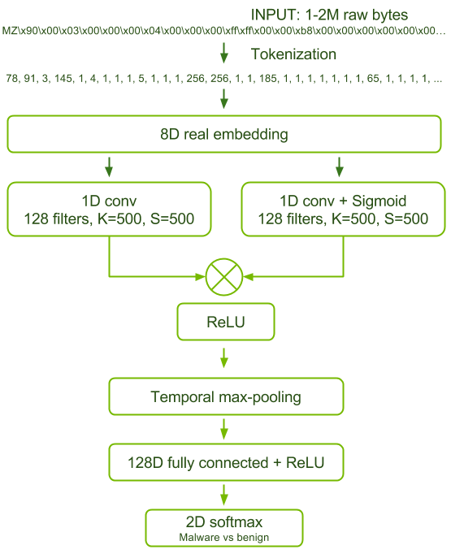
Nvidia Malware Detection [3]
Treat executable bytes like an audio signal
Embedding and convolution
Up to 98.5% AUC
Strong overlap with current approach, but can greatly expand
Use x86 assembly
[3] Barker, “Malware Detection in Executables using Neural Networks”, Nvidia Developer Blog, (2017)

Slide 4
Approach
Want to go even deeper than Nvidia
Scan assembly/machine code to possibly result in malware-detecting hardware?
Acquire samples and disassemble
Tokenize
Feed to neural network
Convert to vector

Slide 5
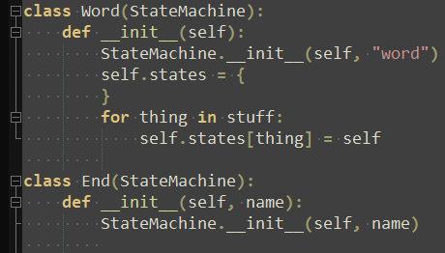
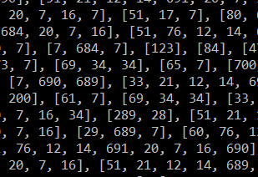
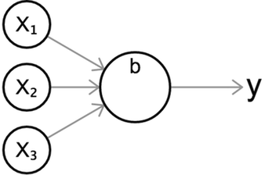
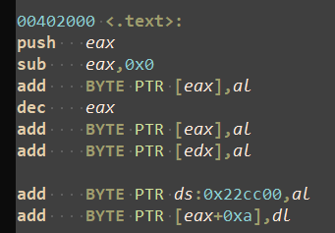
Approach
Assuming contiguous, ordered stream of assembly for current approach
?

Slide 6
Samples
Acquiring samples – 240 total
http://dasmalwerk.eu for malware
Benign samples from C:\ (somewhat normal)
Disassembly
objdump -M intel –d
Intel syntax, only disassemble sections expected to have instructions
Acquire samples and disassemble
Tokenize
Feed to neural network
Convert to vector

Slide 7


Tokenizing
Break input into unique tokens
All hex numbers treated as same token
All function calls treated as same token
Ignore commas
Acquire samples and disassemble
Tokenize
Feed to neural network
Convert to vector

Slide 8

Vectorizing
Looked to NLP for inspiration
Build up vocab of unique tokens across files
Assign each a unique digit and convert, pad
Feed into an embedding (standard NLP)
Each token maps to lookup table of multiple dimensions
Acquire samples and disassemble
Tokenize
Feed to neural network
Convert to vector

Slide 9
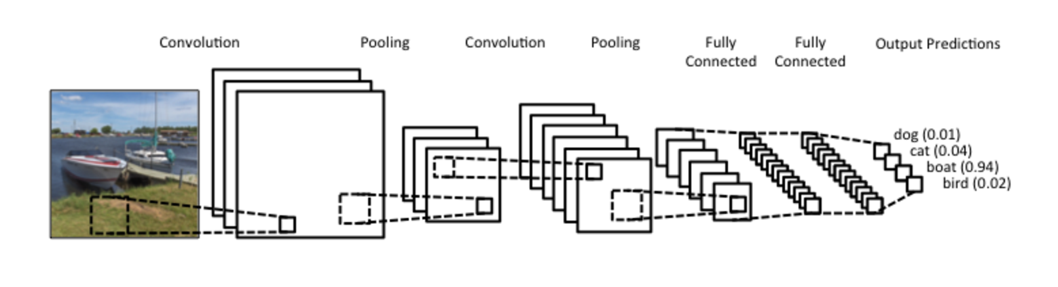
Neural Network
Tried multiple architectures
LSTM (using TBTT), bidirectional LSTM, GRU…
Best: Convolutional neural network
Acquire samples and disassemble
Tokenize
Feed to neural network
Convert to vector
[4] Britz, “Understanding Convolutional Neural Networks for NLP”, WILDML, (2015)

Slide 10
Neural Network
Convolution in sequence on 240 total samples
Data format is 3d vector: (samples, lines of code, tokens), limit to 100k lines
Use max-pooling to reduce number of lines (essentially random)
Time-distributed embedding
2 layers of convolution and max-pooling
Global average pooling and dense layer to finish

Slide 11
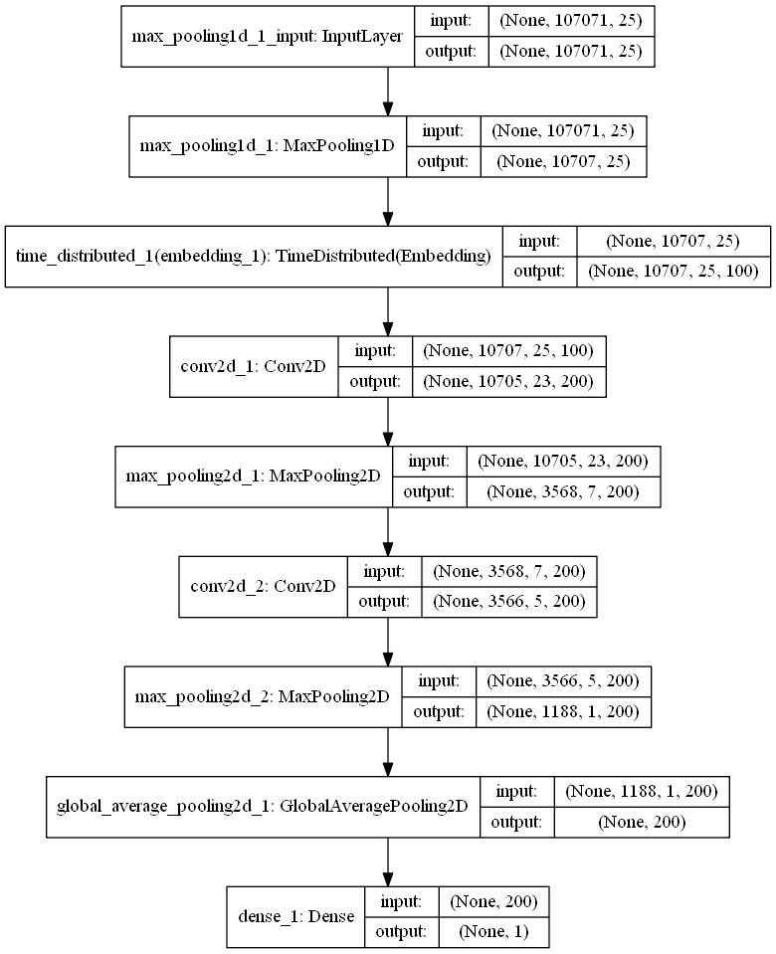
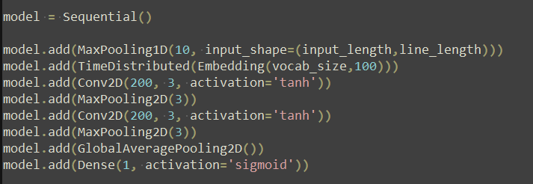
Neural Network
In Keras:

Slide 12
Results – Accuracy/Loss
Accuracy reaches nearly 100%
Validation accuracy max 96%
Most important is reducing FN (next)

Slide 13
Results – Confusion Matrix
Train (160) | Predicted: False | Predicted: True
Actual: False | TN: 82 | FP: 2
Actual: True | FN: 0 | TP: 72
Validation (80) | Predicted: False | Predicted: True
Actual: False | TN: 34 | FP: 2
Actual: True | FN: 3 | TP: 41
Running on model with best validation accuracy
Want to reduce FN as much as possible
Train set had 0 FN

Slide 14
Neural Network – Kaggle
Kaggle dataset provides thousands of samples of 9 types of malware
Want to show network works outside of self-generated data even if only slightly
Convolution in sequence on 500 new samples of maximum length 10k lines
Same data format and network but categorical crossentropy and more nodes per layer

Slide 15
Results – Accuracy/Loss
Accuracy reaches 90%
Validation accuracy max 80%
Much more volatile, but shows concept works

Slide 16
Future Work
In the works:
Expand to any length program
Address 0-day malware
Train/test on much larger datasets
Utilize other network architectures/types
Far away:
Investigate feasibility in hardware

Slide 17
Sources
Idika, Nwokedi, and Aditya P. Mathur. "A survey of malware detection techniques." Purdue University 48 (2007).
Pascanu, Stokes, Sanossian, Marinescu, and Thomas, “Malware classification with recurrent networks”, Acoustics, Speech and Signal Processing (ICASSP), (2015)
Barker, “Malware Detection in Executables using Neural Networks”, Nvidia Developer Blog, (2017)
Britz, “Understanding Convolutional Neural Networks for NLP”, WILDML, (2015)
Lin, Min, Qiang Chen, and Shuicheng Yan. "Network in network." arXiv preprint arXiv:1312.4400 (2013).

